Slide 1
HTTP Response

Slide 2
Agenda
Idea of HTTP status codes
Common HTTP 1.1 status codes
A common front end to various Web search engines
Idea of HTTP response headers
Common HTTP 1.1 response headers
HTTP Response

Slide 3
Setting Status Codes
response.setStatus(int statusCode)
  Use a constant for the code, not an explicit int.
  Constants are in HttpServletResponse
  Names derived from standard message.
  E.g., SC_OK, SC_NOT_FOUND, etc.
response.sendError(int code,
String message)
  Wraps message inside small HTML document
response.sendRedirect(String url)
  Relative URLs permitted in 2.2 and later
  Sets Location header also
HTTP Response

Slide 4
Common HTTP 1.1 Status Codes
200 (OK)
  Everything is fine; document follows.
  Default for servlets.
204 (No Content)
  Browser should keep displaying previous document.
301 (Moved Permanently)
  Requested document permanently moved elsewhere (indicated in Location header).
  Browsers go to new location automatically.
HTTP Response

Slide 5
Common HTTP 1.1 Status Codes (Continued)
302 (Found)
  Requested document temporarily moved elsewhere (indicated in Location header).
  Browsers go to new location automatically.
  Servlets should use sendRedirect, not setStatus, when setting this header. See example.
401 (Unauthorized)
  Browser tried to access password-protected page without proper Authorization header. See example in book.
404 (Not Found)
  No such page. Servlets should use sendError to set this.
  Problem: Internet Explorer 5.0.
  Fun and games: http://www.plinko.net/404/
HTTP Response

Slide 6
Generating the Server Response: HTTP Response Headers
Purposes
  Give forwarding location
  Specify cookies
  Supply the page modification date
  Instruct the browser to reload the page after a designated interval
  Give the document size so that persistent HTTP connections can be used
  Designate the type of document being generated
  Etc.
HTTP Response

Slide 7
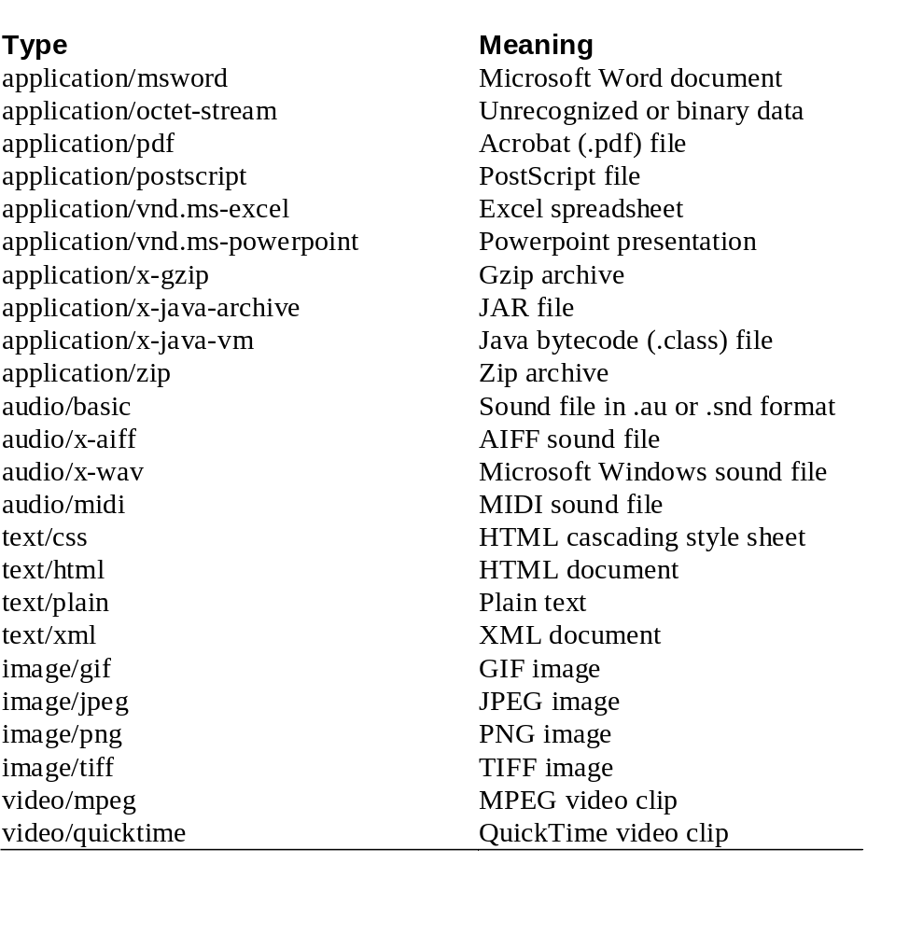
Common MIME Types
HTTP Response

Slide 8
Common HTTP 1.1 Response Headers
Cache-Control (1.1) and Pragma (1.0)
  A no-cache value prevents browsers from caching page. Send both headers or check HTTP version.
Content-Encoding
  The way document is encoded. Browser reverses this encoding before handling document. See compression example earlier.
Content-Length
  The number of bytes in the response.
  See setContentLength on previous slide.
  Use ByteArrayOutputStream to buffer document before sending it, so that you can determine size. See discussion of the Connection request header and detailed example in book.
HTTP Response

Slide 9
Common HTTP 1.1 Response Headers (Continued)
Content-Type
  The MIME type of the document being returned.
  Use setContentType to set this header.
Expires
  The time at which document should be considered out-of-date and thus should no longer be cached.
  Use setDateHeader to set this header.
Last-Modified
  The time document was last changed.
  Don’t set this header explicitly; provide a getLastModified method instead.
  See example in CSAJSP Chapter 2.
HTTP Response

Slide 10
Common HTTP 1.1 Response Headers (Continued)
Location
  The URL to which browser should reconnect.
  Use sendRedirect instead of setting this directly.
Refresh
  The number of seconds until browser should reload page. Can also include URL to connect to.
  See following example.
Set-Cookie
  The cookies that browser should remember. Don’t set this header directly; use addCookie instead. See next section.
WWW-Authenticate
  The authorization type and realm needed in Authorization header. See example in CSAJSP Section 4.5.
HTTP Response

Slide 11
Summary
Most important status codes
  200 (default)
  302 (forwarding; set via sendRedirect)
  401 (password needed)
  404 (not found; set via sendError)
Most important headers you set directly
  Cache-Control and Pragma
  Content-Encoding
  Content-Length
  Expires
  Refresh
  WWW-Authenticate
HTTP Response

Slide 12
Questions?
Core Servlets & JSP book: www.coreservlets.com
More Servlets & JSP book: www.moreservlets.com
Servlet and JSP Training Courses: courses.coreservlets.com

